Slide 1

Employee Management Module

Slide 2
Employee Management Module
Employee On-Boarding

Slide 3
Employee On-Boarding Process
1. Adding Employee Profile and assigning Employee Group
2. Adding Employee Join/Resignation Details
3. Adding Employee Profile (Address)
4. Adding Employee Salary
5. Adding Employee Statutory
6. Adding Fixed Allowance
7. Adding Employee Bank Details

Slide 4
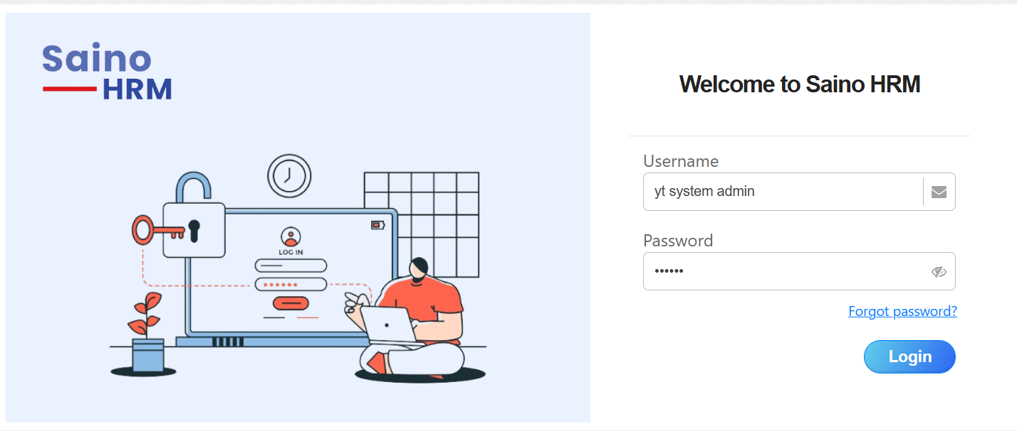
Employee Portal Login
1) Access the Main Portal(Super Admin)
1- Insert Username/Email Address
3- Click Login
2- Insert Password

Slide 5
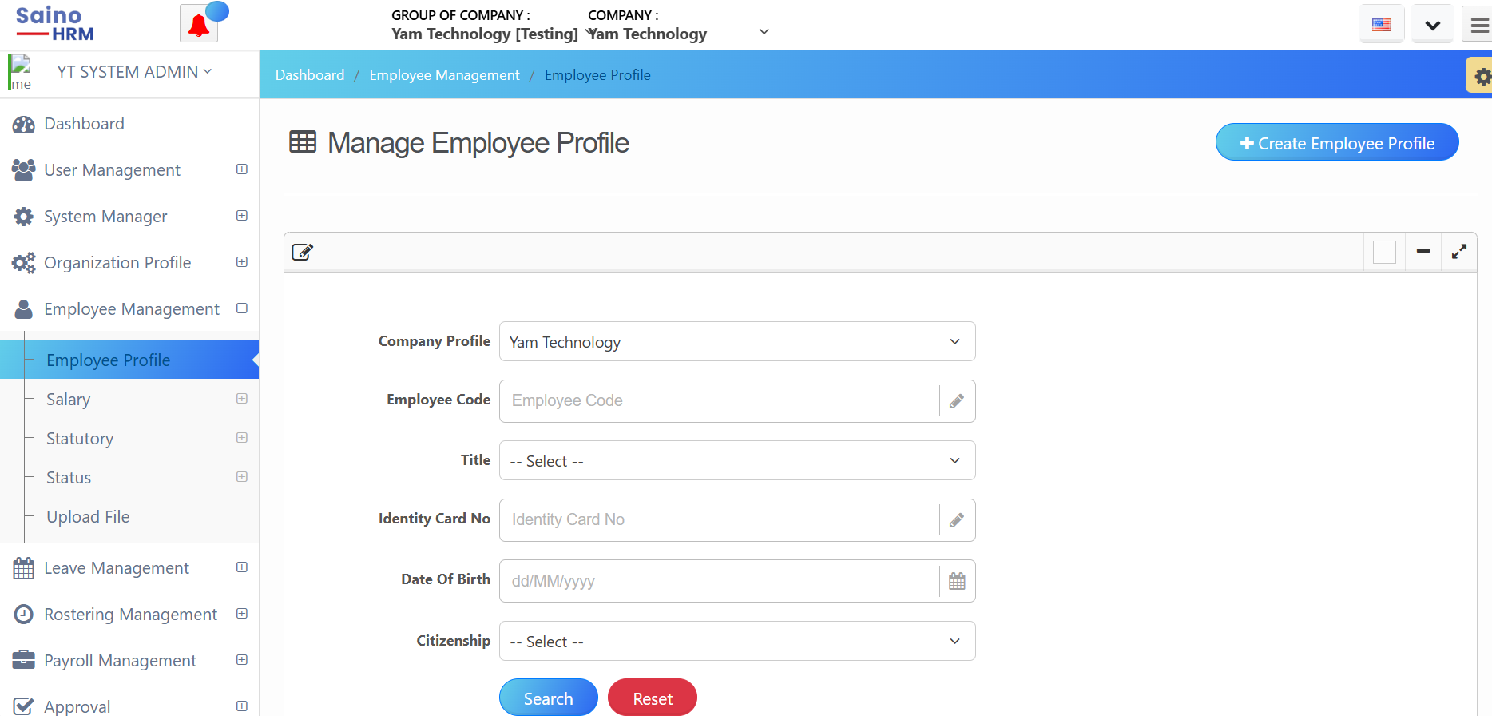
Employee On-Boarding Process- Adding Employee Profile
1) Main Portal > Accessing ‘Employee Management’ >Access ‘Employee Profile'
1- Access ‘Employee Management’
3- Click ‘Create Employee Profile’
2- Access ‘Employee Profile’

Slide 6
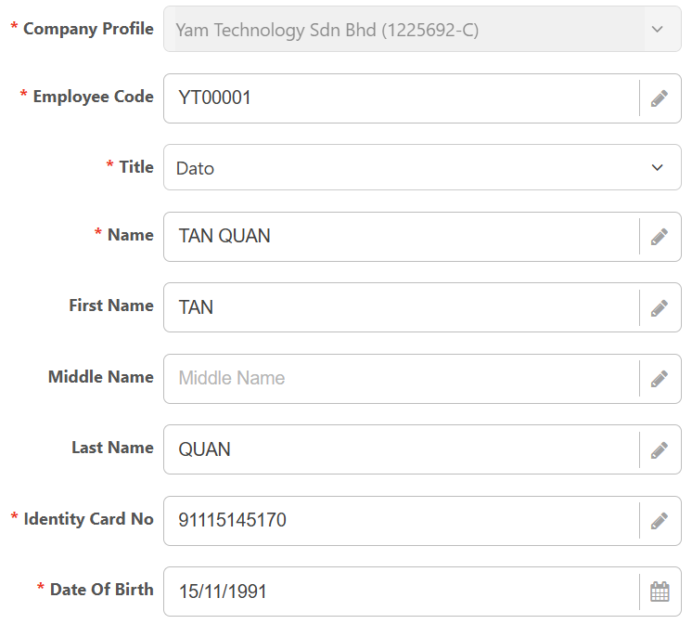
Employee On-Boarding Process - Creating Employee Profile
2) Adding Employee Profile
4-Company Profile update automatically
5- Insert ‘Employee Code/ID’
(the employee code/ID cannot be the same)
6- Select ‘Employee Title’
Not Mandatory
7- Insert ‘Employee Name’
Not Mandatory
Not Mandatory
8- Insert ‘Employee IC’
9- Select ‘Date of Birth’ from calendar only
(You can input your desired year for the date of birth)

Slide 7
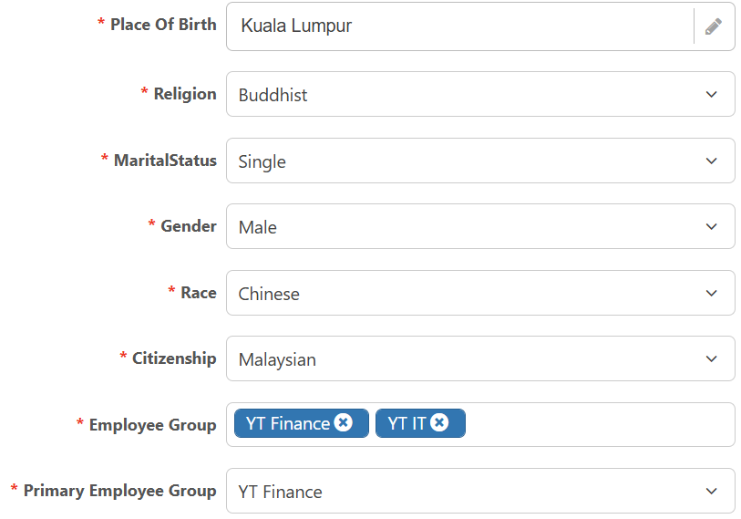
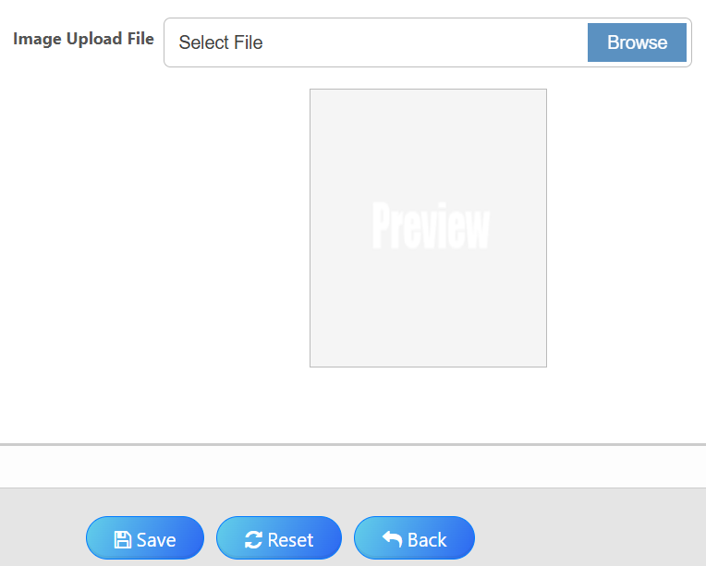
Employee On-Boarding Process - Creating Employee Profile
3) Cont- Adding Employee Profile
10- Insert ‘Place of Birth’
11- Select ‘Religion’
12- Select ‘Marital Status’
13- Select ‘Gender’
14- Select ‘Race’
18- Upload Image File
15- Select ‘Citizenship’
16- Assign ‘Employee Group’
19- Click ‘Save’ once done
17- Select ‘Primary Employee Group’

Slide 8
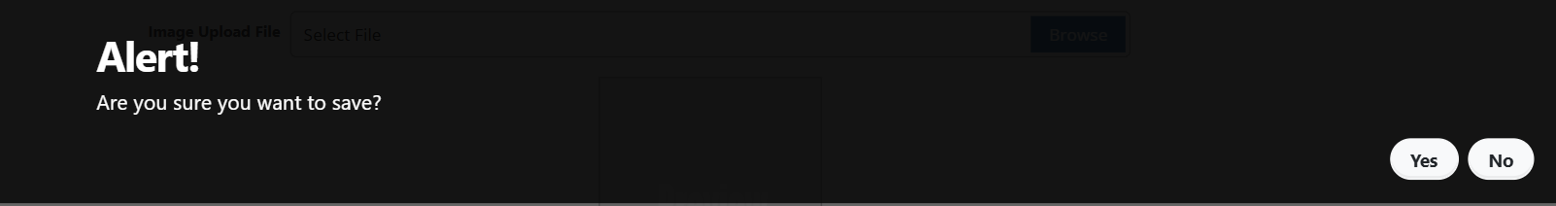
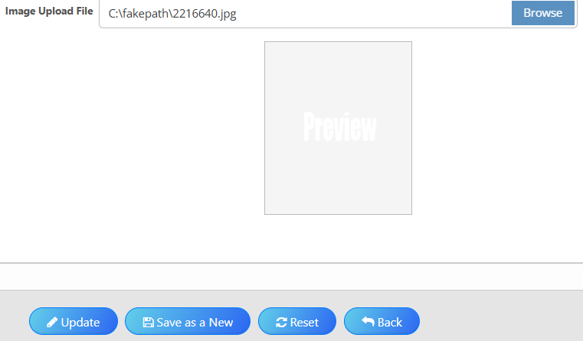
Employee On-Boarding Process - Creating Employee Profile
4) A prompt message will appear once the record is saved
5) Then click ‘ Back'
20- Click ‘Yes’
21- Click ‘Back’

Slide 9
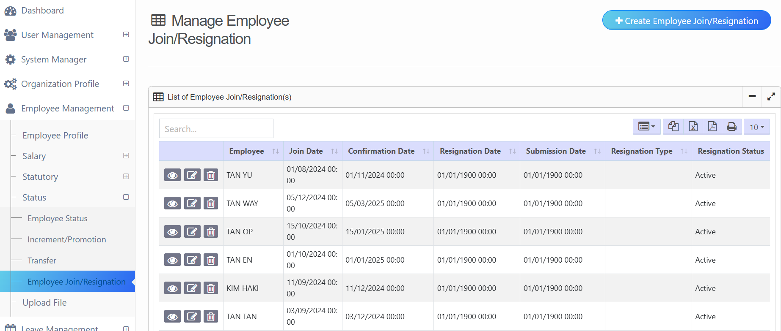
Employee On-Boarding Process - Employee Join/Resignation
1) Access ‘Employee Management’ > Access ‘Status’ > Access ‘Employee Join/Resignation’
1- Access ‘Employee Management’
2- Access ‘Status’
3- Access ‘Employee Join/Resignation’

Slide 10
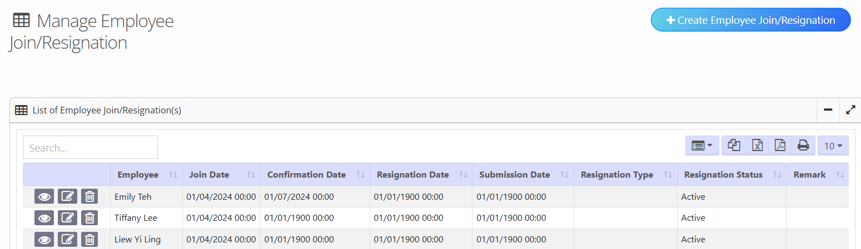
Employee On-Boarding Process - Employee Join/Resignation
2) Create New Employee Join/Resignation
4- Click ‘Create Employee Join/Resignation’

Slide 11
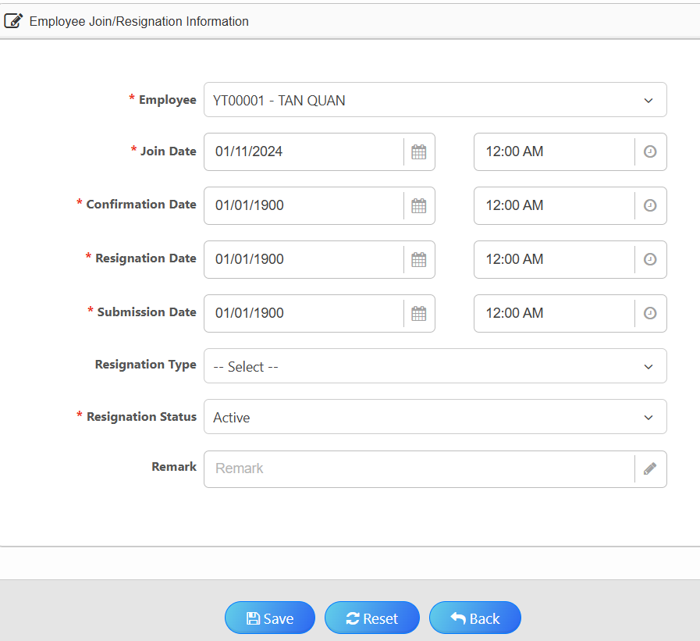
Employee On-Boarding Process - Employee Join/Resignation
3) Adding Employee Join/Resignation details
5- Select Employee
6- Automatically populate with the current date of creation
7- Default date and time
8- Select ‘Resign Type’ if application
9- Select Resignation Type
10- Insert ‘Remark’ if application
11- Click ‘Save’ once done

Slide 12
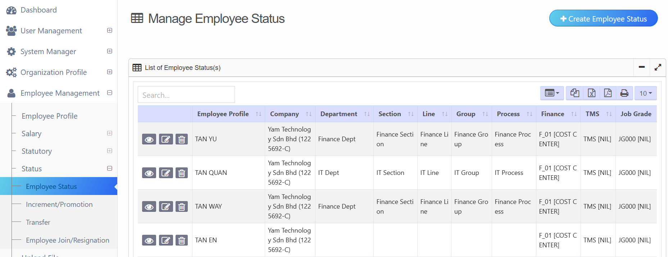
Employee On-Boarding Process - Adding Employee’s Job Details
1) Access ‘Employee Management’ > Access ‘Status’ > Access ‘Employee Status’ > Click ‘Create Employee Status’
4- Click ‘Create Employee Status’
1- Access ‘Employee Management’
2- Access ‘Status’
3- Access ‘Employee Status’

Slide 13
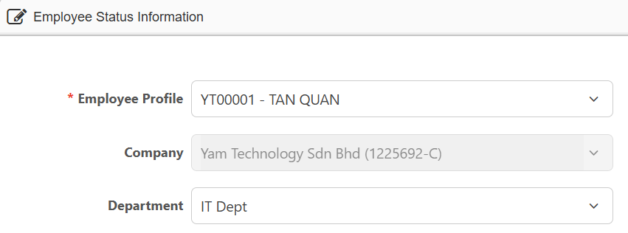
Employee On-Boarding Process - Adding Employee’s Job Details
2) Select Department (if applicable)
5- Select Employee
6- Company update automatically
7- Select only if applicable

Slide 14
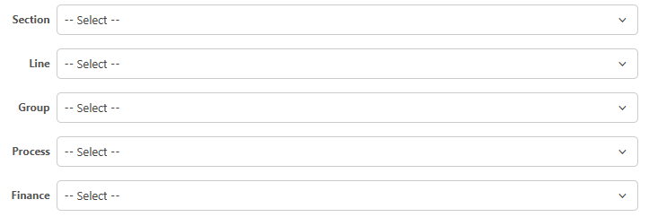
Employee On-Boarding Process - Adding Employee’s Job Details
3) Select these details only if applicable
8- Select only if applicable

Slide 15
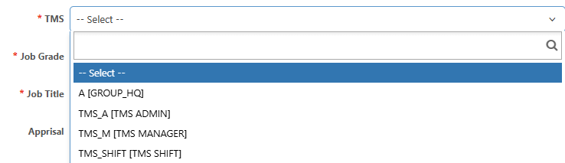
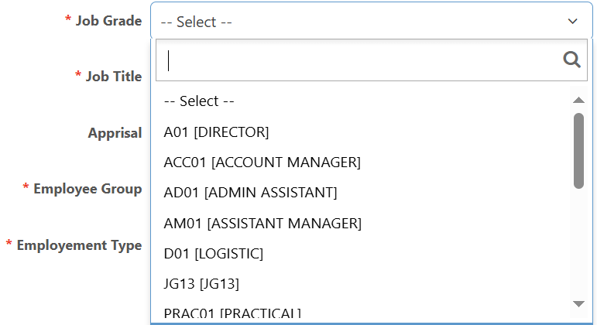
Employee On-Boarding Process - Adding Employee’s Job Details
4) Select Employee TMS, which is Employee Work Shift.
9- Select TMS
5) Select Employee Job Grade.
10- Select Employee Job Grade

Slide 16
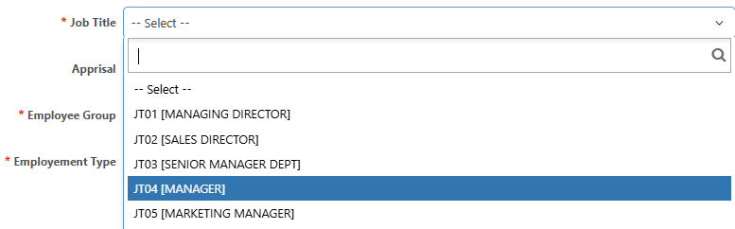
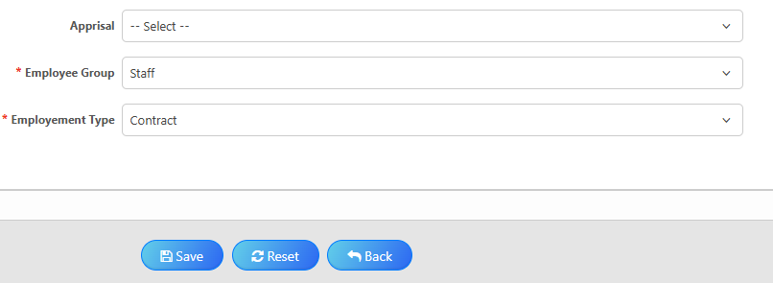
Employee On-Boarding Process - Adding Employee’s Job Details
6) Select Employee Job Title
7- Select Employee’s Job Title
7) Select Employee Group, Employment Type and Click ‘Save’
8- Select if applicable
9- Select Employee Group
10- Select Employee Type
11- Click save once done

Slide 17
Employee On-Boarding Process - Adding Employee’s Job Details
8) Message will prompt upon saving - Click ‘Yes’, then click ‘Back’
12- Click ‘Back’ once record saved

Slide 18
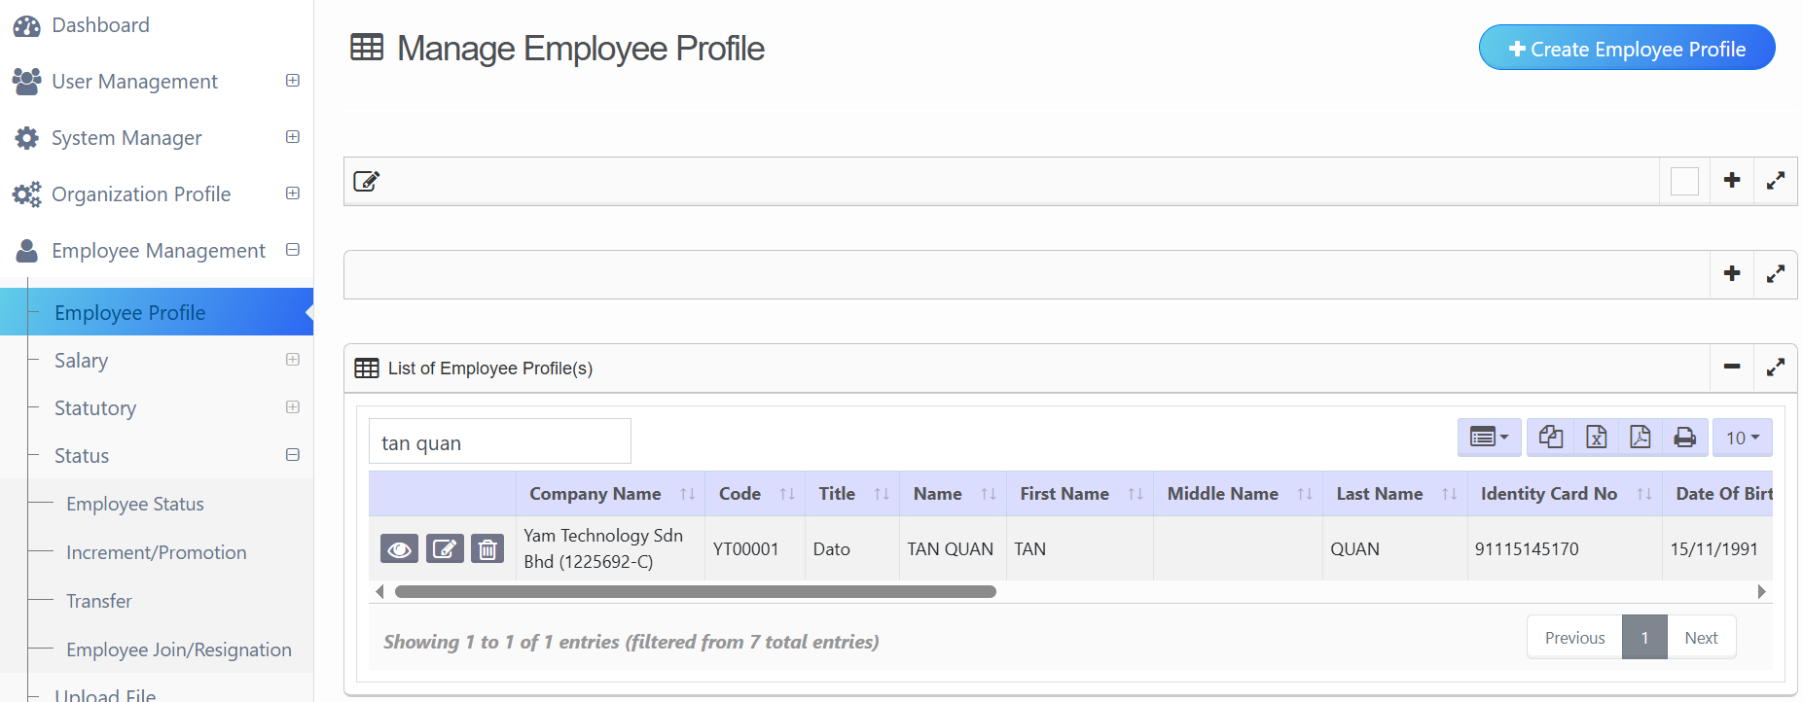
Employee On-Boarding Process - Adding Employee Profile (Address)
1) Main Portal > Access ‘Employee Management’ > Access ‘Employee Profile’ > Click ‘Maintenance’
1- Access ‘Employee Management’
2- Access ‘Employee Profile’
3- Click ‘Maintenance’
Notes:
Address

Slide 19
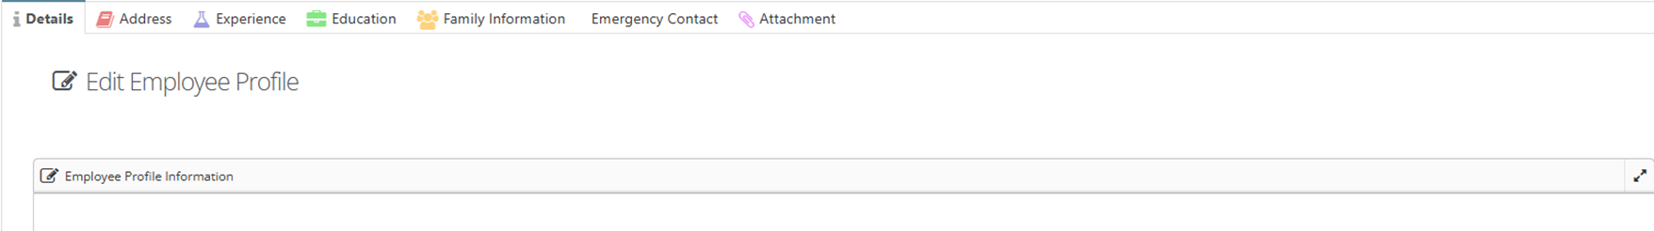
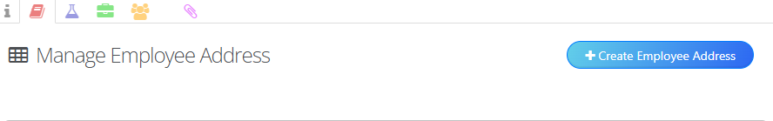
Employee On-Boarding Process - Adding Employee Profile (Address)
2) Access ‘Address’ tab > Click ‘Create Employee Address’
4- Click ‘Address’
5 – Click ‘Create Employee Address’

Slide 20
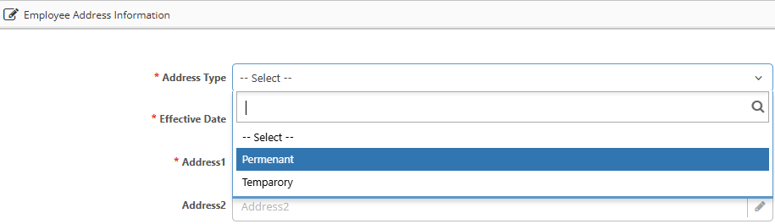
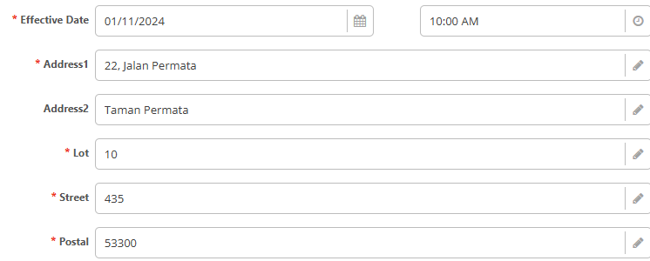
Employee On-Boarding Process - Adding Employee Profile (Address)
3) Proceed to add address details
6- Select Address Type
7- Select Effective Date and Time from calendar
9- Fill up if application
8- Fill up the necessary

Slide 21
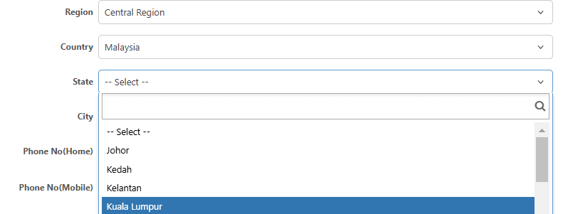
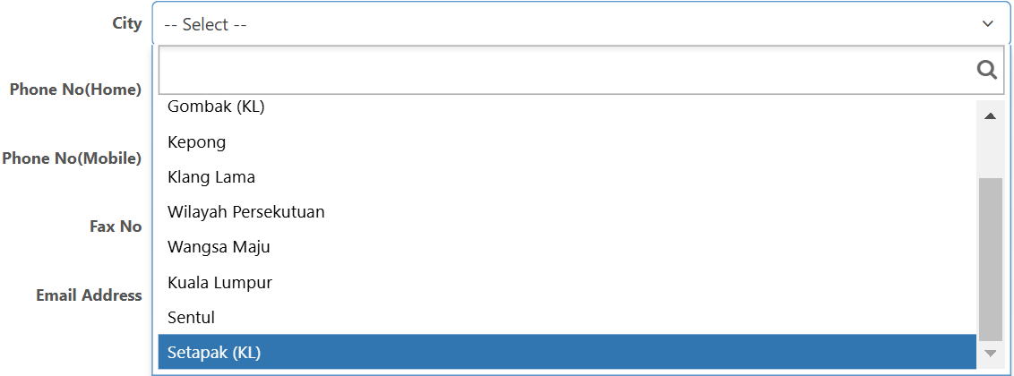
Employee On-Boarding Process- Adding Employee Profile (Address)
4) Upon selecting the ‘Country’, will derive selection of ‘State’, then selection of ‘city’
9- Select ‘Region’
10- Select ‘Country’
11- State Listing appear
12- City Listing appear

Slide 22
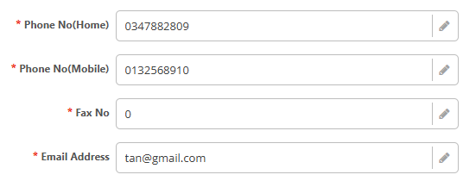
Employee On-Boarding Process - Adding Employee Profile (Address)
5) Continue with the necessary information and click ‘Save’ once done
13- Continue as required
14- Click ‘Save’ once completed

Slide 23
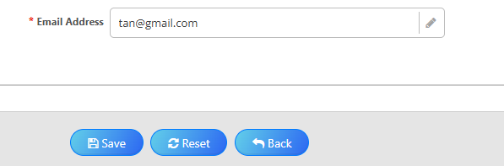
Employee On-Boarding Process - Adding Employee Profile (Address)
6) Message will prompt upon saving - Click ‘Yes’ , then click ‘Back'
15- Click ‘Back’ once record saved
Notes:
Stop until slide 28

Slide 24
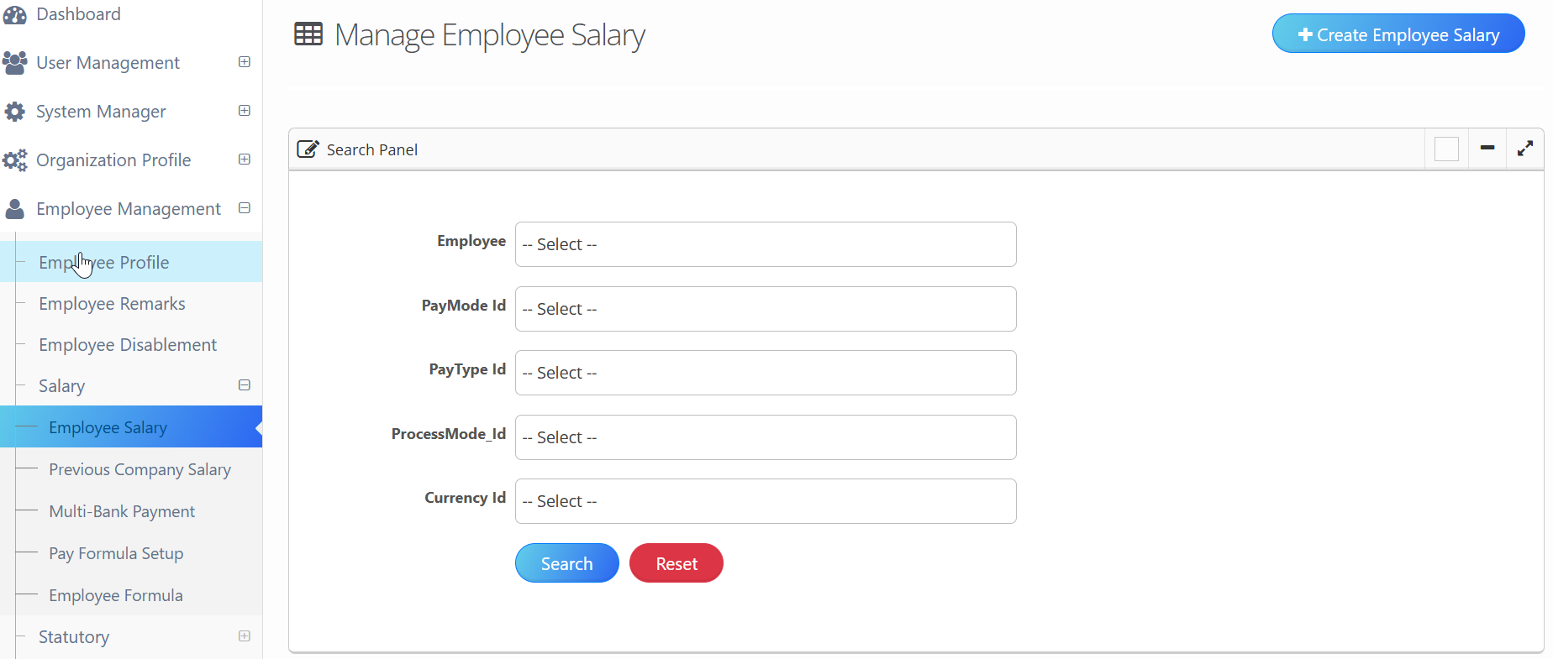
Employee On-Boarding Process - Adding Employee Details (Salary)
1) Access ‘Employee Management’ > Access ‘Salary’ > Access ‘Employee Salary’
1- Access ‘Employee Management’
2- Access ‘Salary’
3- Access ‘Employee Salary’

Slide 25
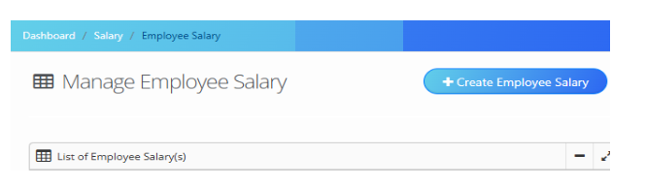
Employee On-Boarding Process - Adding Employee Details (Salary)
2) Create New Employee Salary
4- Click ‘Create Employee Salary’

Slide 26
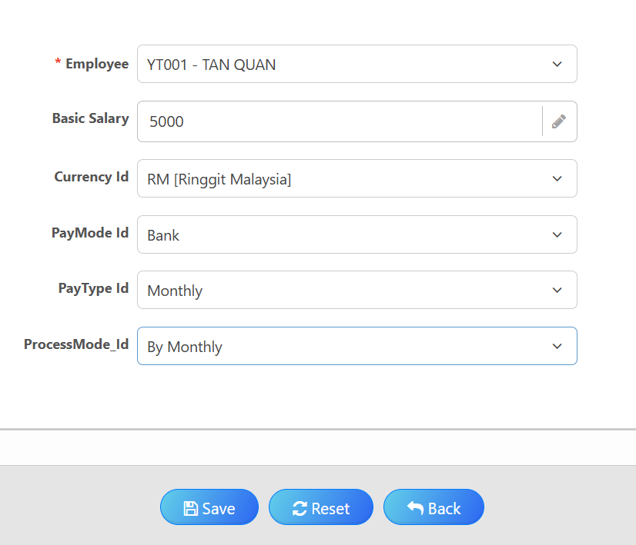
Employee On-Boarding Process- Adding Employee Details (Salary)
3) Adding the Employee's Basic Salary
5- Select Employee
6- Insert Basic Salary
7– Select ‘Currency Id’
8–Select ‘PayMode Id’
9– Select ‘PayType Id’
10– Select ‘ProcessMode_Id’
11- Click ‘Save’ once done

Slide 27
Employee On-Boarding Process- Adding Employee Details (Salary)
4) Message will prompt upon saving - click ‘Yes’, then click ‘Back’
12- Click ‘Back’ once record saved

Slide 28
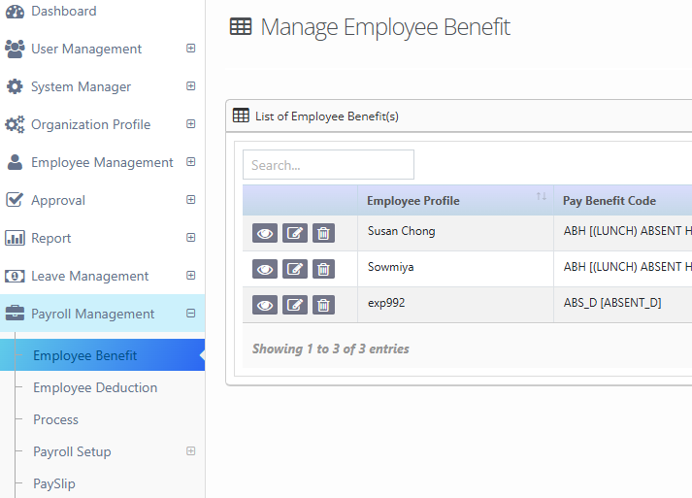
Employee On-Boarding Process - Adding Employee Details (Allowance)
1) Access Payroll Management > Access Employee Benefit
: Adding the Employee’s Fixed monthly allowance, such as Travel Allowance, Transport Allowance, etc.
1- Access ‘Payroll Management’
2- Access ‘Employee Benefit’

Slide 29
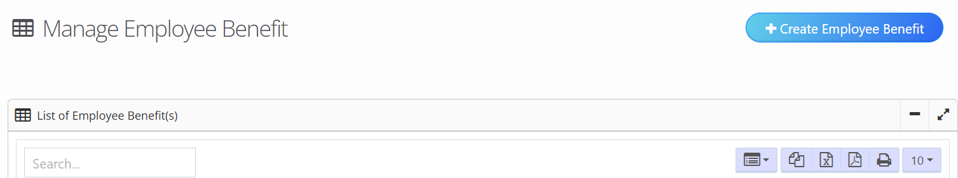
Employee On-Boarding Process - Adding Employee Details (Allowance)
2) Create New Employee Benefit
3- Click ‘Create Employee Benefit’

Slide 30
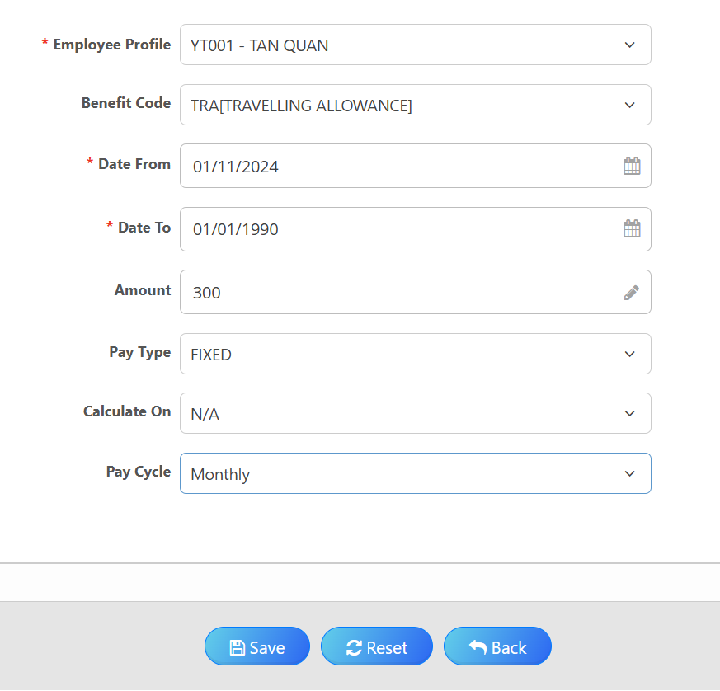
Employee On-Boarding Process-Adding employee Details (Allowance)
3) Adding Employee Allowance Details
4- Select ‘Employee Profile’
c
5- Select Allowance Type
c
6- Select Start Date from the Calendar
7- Insert :
Default/Fixed Date for ‘Fixed Allowance’.
End date for ‘Non-fixed Allowance’.
8- Insert Amount
9- Insert Default Details
10- Click ‘Save’ once done

Slide 31
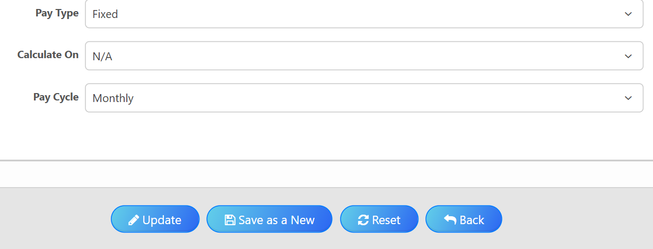
Employee On-Boarding Process-Adding employee Details (Allowance)
4) Message will prompt upon saving-click ‘Yes’ , then click ‘Back’
11- Click ‘Back’ once record saved

Slide 32
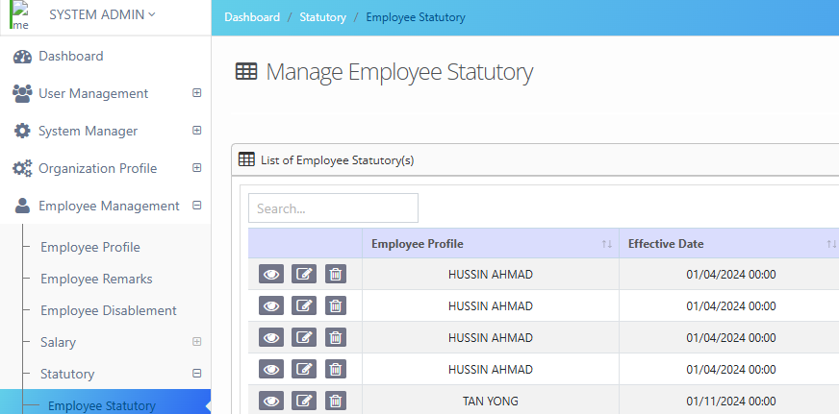
Employee On-Boarding Process- Adding Statutory Details
1) Main Portal > Accessing ‘Employee Management’ >Access ‘Statutory’> Access ‘Employee Statutory’
1- Access ‘Employee Management’
2- Access ‘Statutory’
3- Access ‘Employee Statutory’

Slide 33
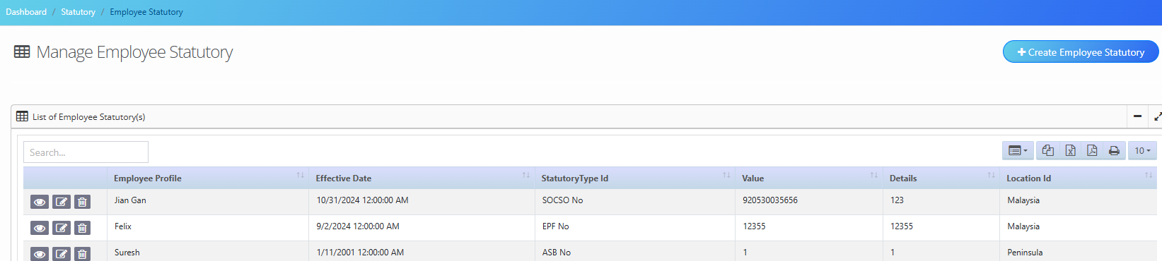
Employee On-Boarding Process- Adding Statutory Details
2) Adding Employee Statutory details
4- Click ‘Create Employee Statutory’

Slide 34
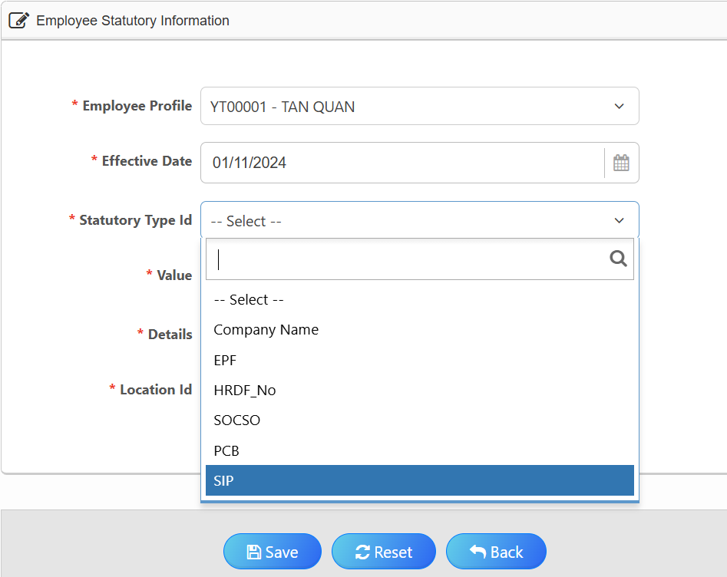
Employee On-Boarding Process - Adding Statutory Details (EPF)
3) Adding the Statutory details
5- Select Employee Profile
6- Select the effective from calendar only
7- Select Type of Statutory

Slide 35
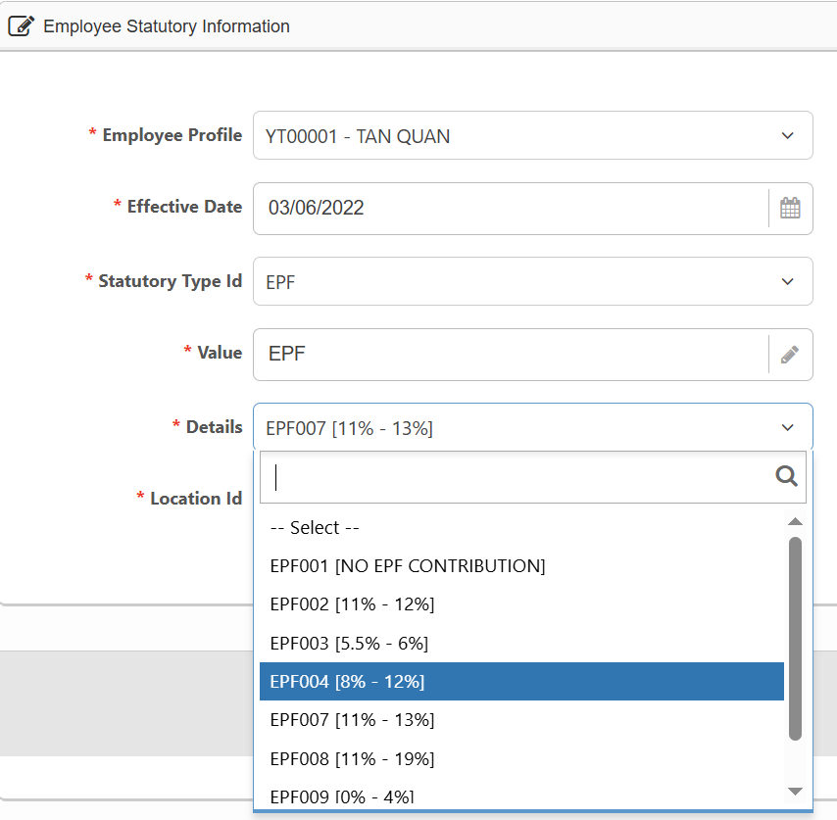
Employee On-Boarding Process- Adding Statutory Details (EPF)
4) Adding the Statutory Details
8- Select ‘Statutory Details’
Select for employee with ‘No EPF contribution’
(exp: Contract staff, Part time Staff and Foreigner)
Select for employee with ‘EPF contribution’
(exp: Permanent Staff)

Slide 36
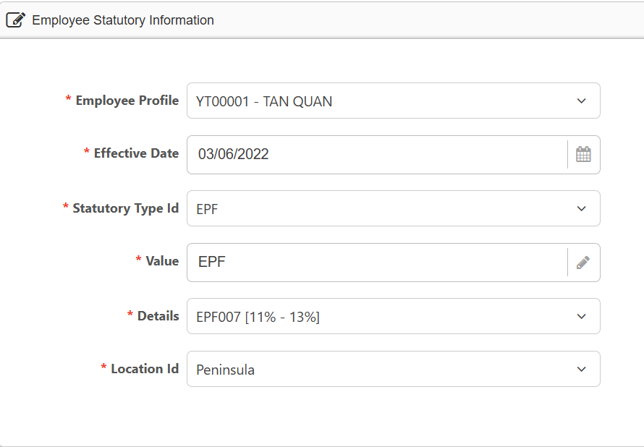

Employee On-Boarding Process - Adding Statutory Details (EPF)
4) Adding the Statutory Details
9- Insert EPF no
10- Select Location
11- Click ‘Save’ once done

Slide 37
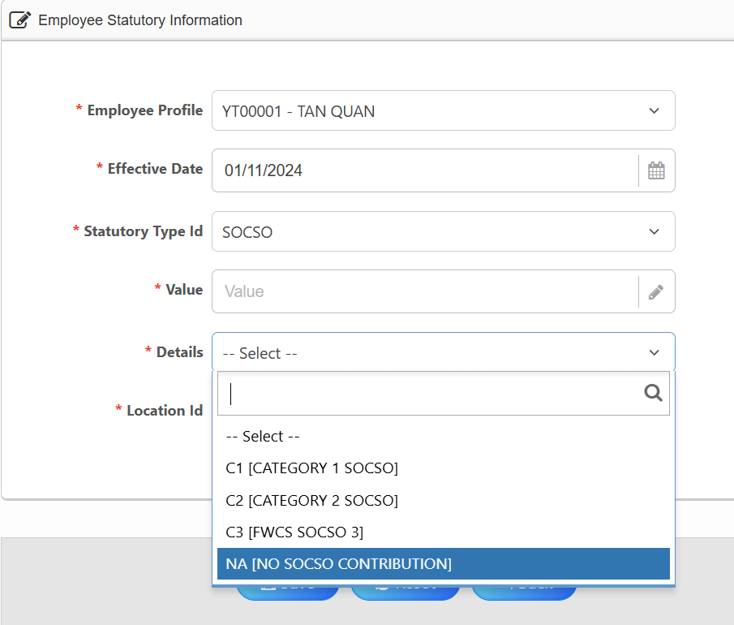
Employee On-Boarding Process- Adding Statutory Details (SOCSO)
5) Repeat Steps to add Employee Statutory Details.
6) Select Statutory Type ‘SOCSO’ and complete the details.
12- Select ‘SOCSO’
13- Select ‘Socso’ Details
Select for employee with ‘Socso contribution’
For Malaysian only
Select for employee with ‘Socso contribution’
For Foreigner Employee - Effective 1st July 2024
Select for employee with ‘No Socso contribution’
(exp: Contract staff, Part time Staff)

Slide 38
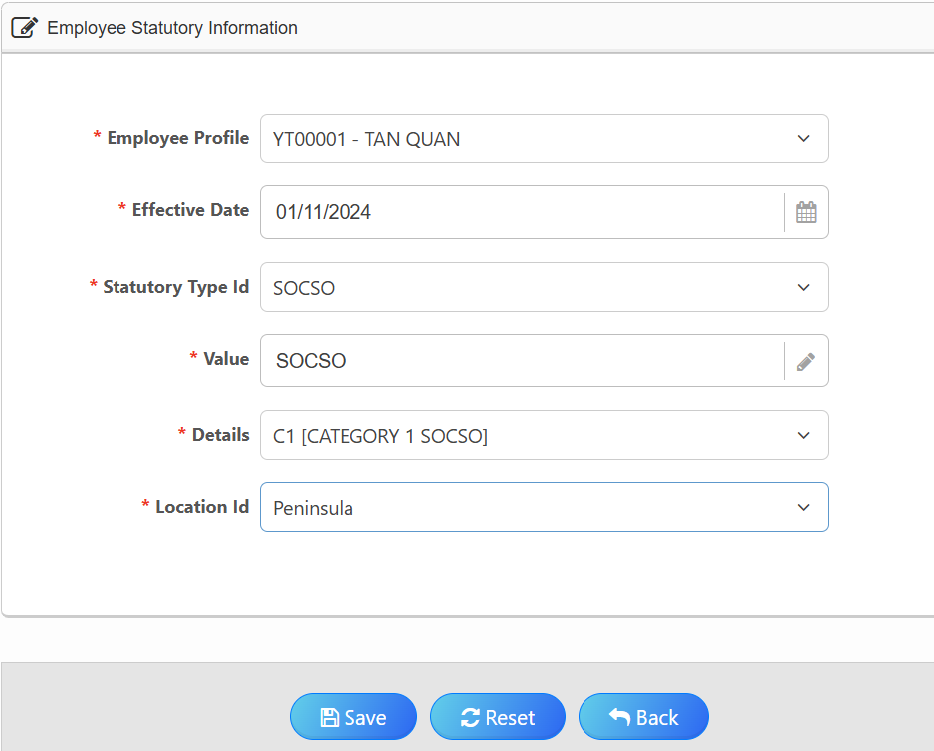
Employee On-Boarding Process- Adding Statutory Details (SOCSO)
7) Completing the Statutory Details
14- Insert SOCSO Value
15- Select Location
16- Click ‘Save’ once done

Slide 39
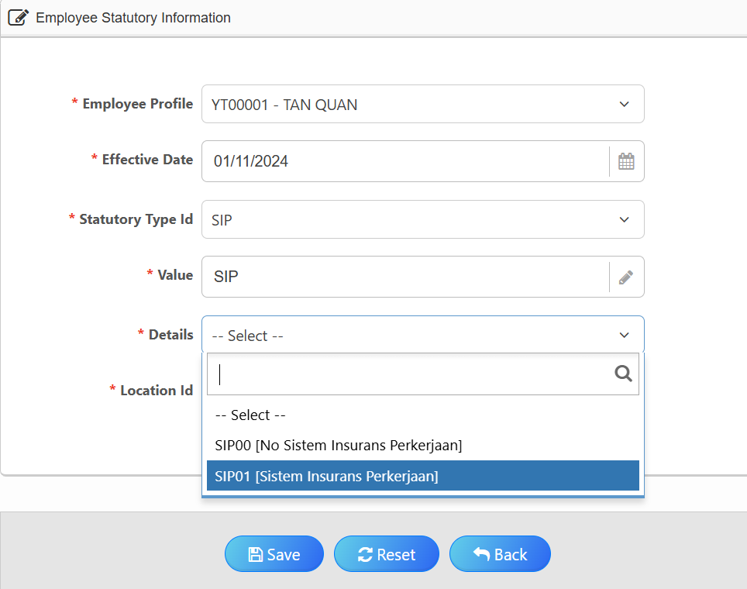
Employee On-Boarding Process- Adding Statutory Details (EIS)
8) Repeat Steps Statutory details - Only for Malaysian Employee with IC
17-Select ‘SIP’
18- Select ‘SIP’ Details
Select for employee with ‘EIS contribution’
(exp: Malaysian only- Permanent Staff)

Slide 40
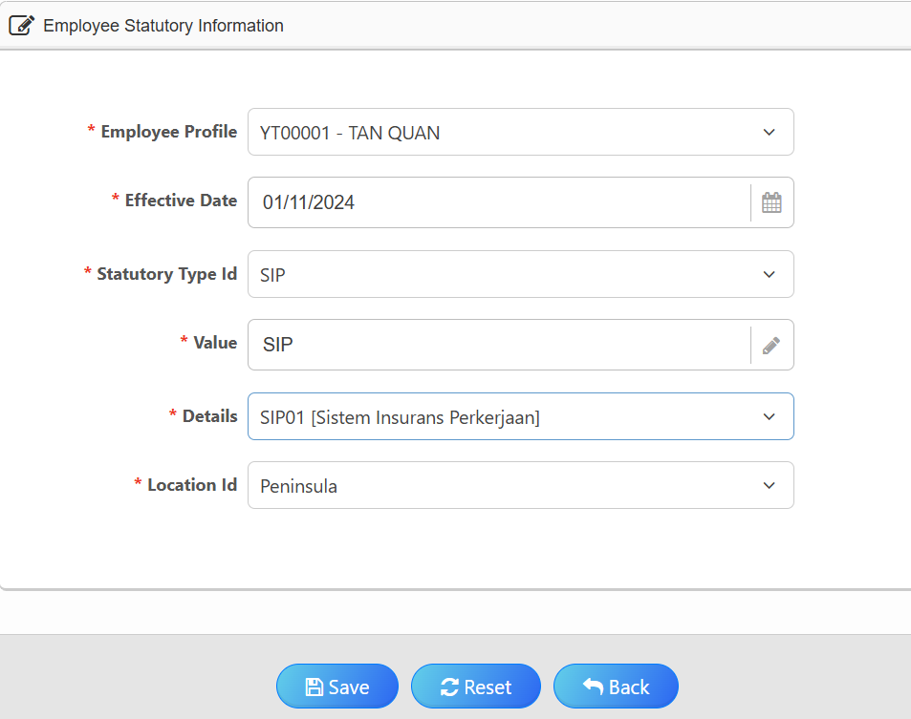
Employee On-Boarding Process- Adding Statutory Details (EIS)
9) Completing the Statutory Details
19- Insert EIS Value
20- Select Location
21- Once completed, click ‘Save’

Slide 41
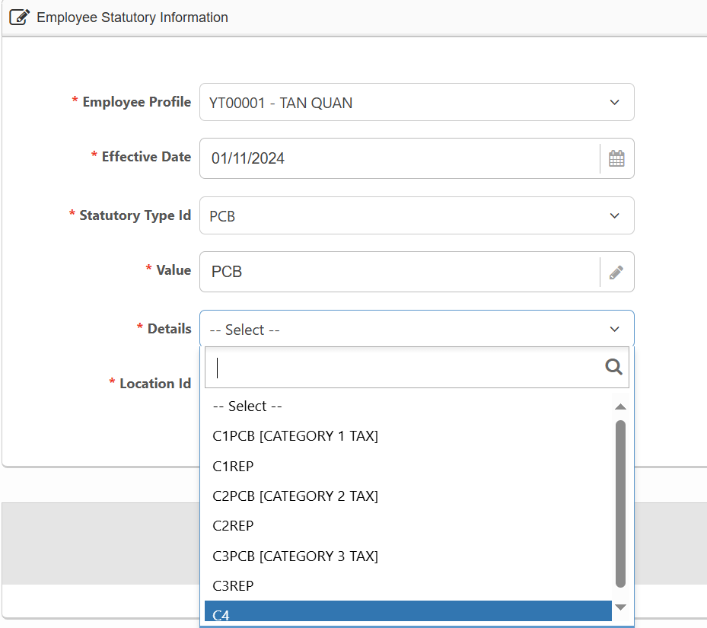
Employee On-Boarding Process-Adding Employee Details (PCB)
10) Repeat Steps
22- Select ‘PCB’
23- Select ‘Statutory Details’
Select for employee with ‘PCB’
(exp: Permanent Staf)

Slide 42
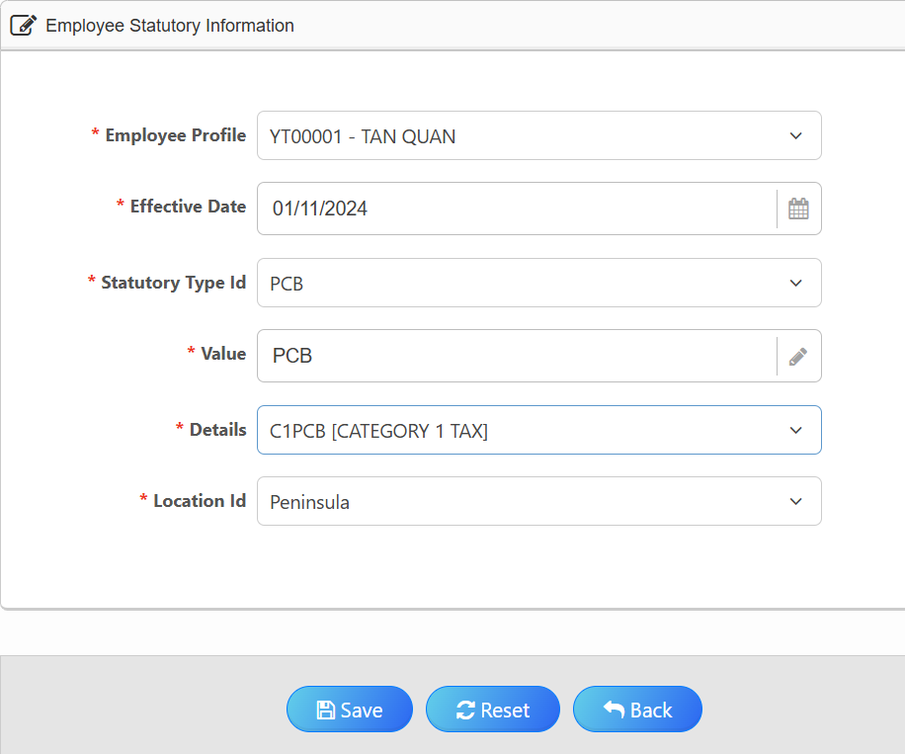
Employee On-Boarding Process-Adding Employee Details (PCB)
11) Completing the PCB Details
24- Insert PCB No
25- Select Location
26- Click ‘Save’ once done

Slide 43
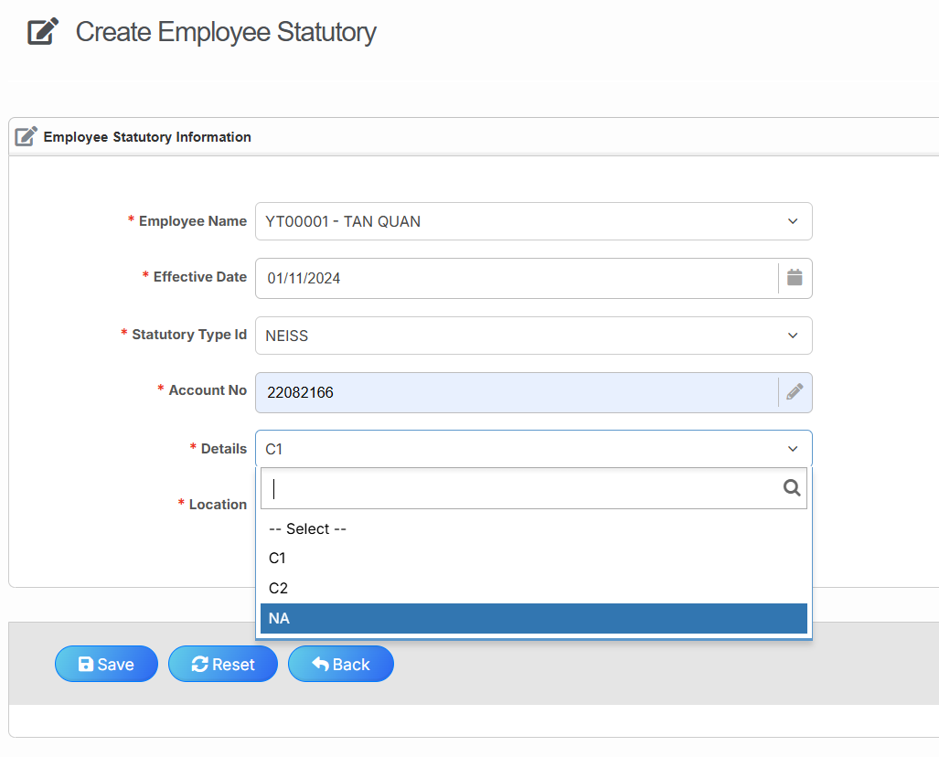
Employee On-Boarding Process-Adding Employee Details (NEISS)
12) Repeat Steps
27- Select ‘NEISS’
28- Select ‘NEISS Details’
Select for employee with ‘C1’
(Employment Injury and invalidity schemes)
Select for employee with ‘C2’
(Employment Injury schemes only)
Select for employee with ‘NA’
(Exempt from NEISS contributions)

Slide 44
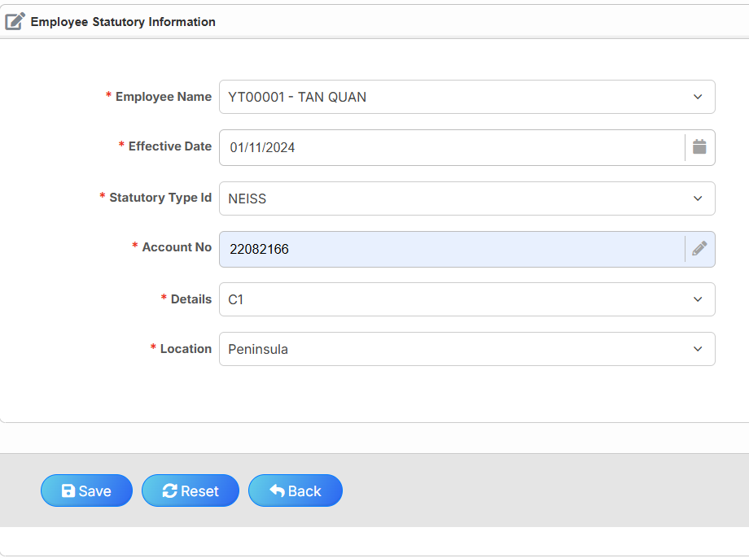
Employee On-Boarding Process-Adding Employee Details (NEISS)
13) Completing the NEISS Details
29- Insert NEISS No
30- Select Location
31- Click ‘Save’ once done

Slide 45
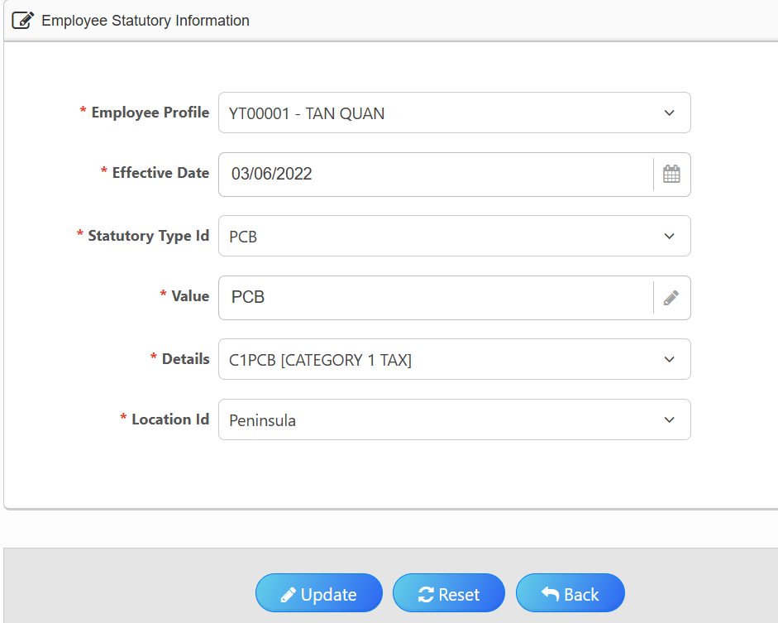
Employee On-Boarding Process - Adding Statutory Details
14) Message will prompt upon saving - Click ‘Yes’ , then click ‘Back’
32- Click ‘Back’ once done

Slide 46
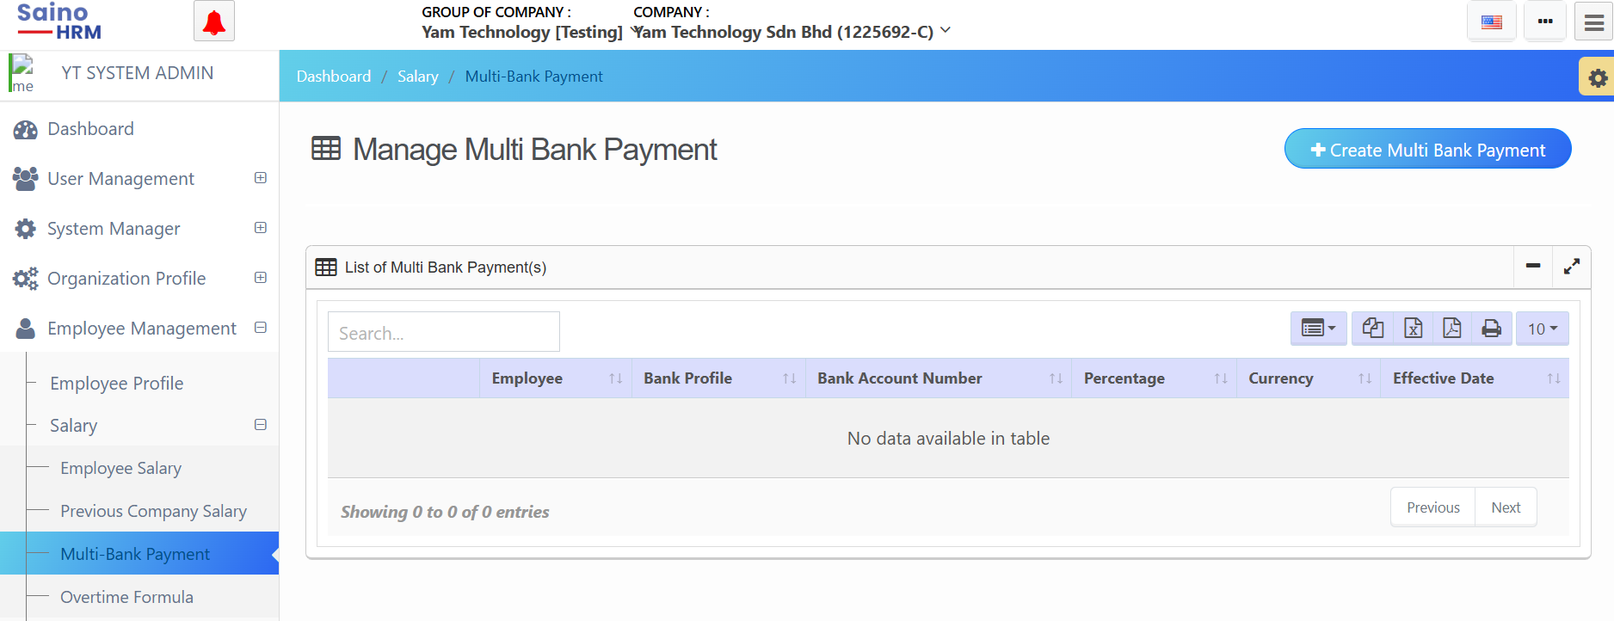
Employee On-Boarding Process - Adding Employee Details (Bank Details)
1) Main Portal > Access ‘Employee Management’ > Access ‘Salary’ > Access ‘Multi-Bank Payment’
1- Access ‘Employee Management’
2- Access ‘Salary’
3- Access ‘Multi-Bank Payment’

Slide 47
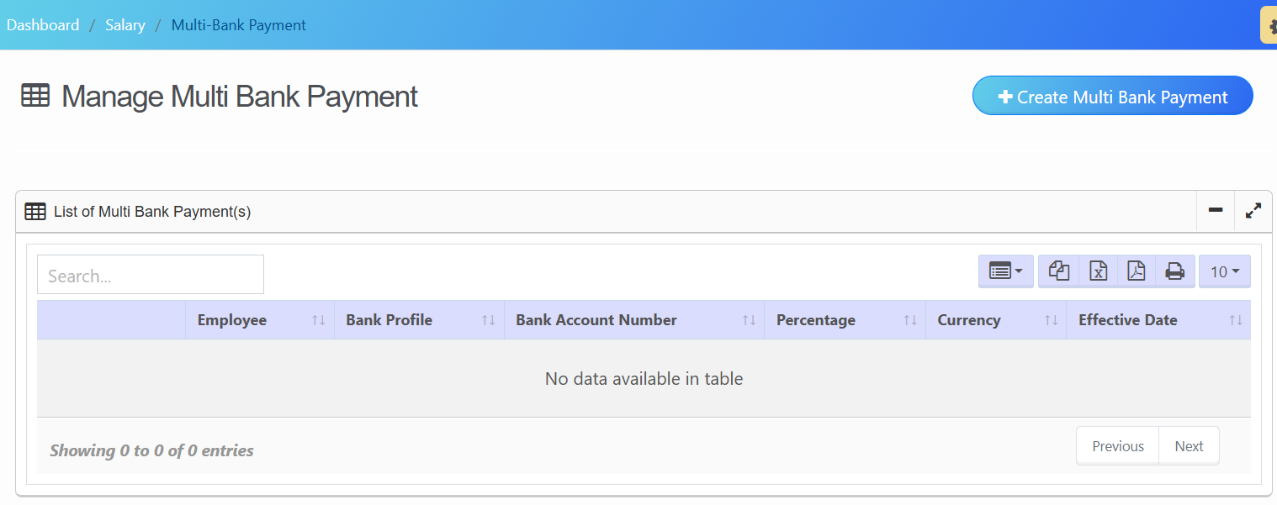
Employee On-Boarding Process - Adding Employee Details (Bank Details)
2) Adding Employee Bank Details
4- Click ‘Create Multi Bank Payment’

Slide 48
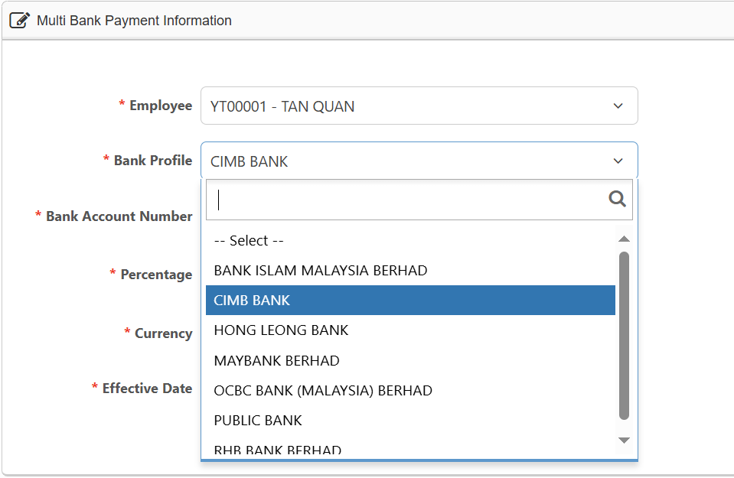
Employee On-Boarding Process - Adding Employee Details (Bank Details)
3) Adding Employee Bank Details
5- Search for Employee Profile
6- Select Bank Profile

Slide 49

Employee On-Boarding Process - Adding Employee Details (Bank Details)
3) Cont- Complete Employee Bank Details
7- Insert Bank Account No
8- Set as default
9- Select effective date and time from calendar
10- Click ‘Save’ once done

Slide 50

Employee On-Boarding Process - Ensuring Employee Join Date
1) Access ‘Employee Management’ > Access ‘Statutory’ > Access ‘Working/Non-Work Child’ > Click ‘Create Child Working Status’
1- Access ‘Employee Management’
4- Click ‘Create Employee Child Working Status’
2- Access ‘Statutory’
3- Access ‘Working/Non-Work Child’

Slide 51

Employee On-Boarding Process - Adding Employee’s Job Details
2) Select Working/Non-Work Child (if applicable)
1- Select Employee Profile
2- Insert ‘Work Child’
If ‘Single’ or ‘No child’ put ‘0’.
3- Insert “Non Work Child”
If ‘Single’ or ‘No child’ put ‘0’.
4- Select Spouse Work Status
5- Click ‘Save’ once done

Slide 52
Employee Management Module
Employee’s Maintenance

Slide 53

Employee’s Maintenance - Create Employee’s User ID
1) Access ‘User Management’ >Access ‘User’ > Access ‘Create User’
1- Access ‘User Management’
2- Access ‘User’
3- Access ‘Create User’

Slide 54

Employee’s Maintenance - Create Employee’s User ID
2) Adding Employee Details
4- Select Company Profile
5- Select User Role
6- Insert Name
7- Create Username (usually user ID)
8- Insert Email Address
9- Create Password
10- Select Language Profile
11- Select Employee Group
13- Select Status ‘Active’
14- Select Is Lock ‘No’
15- Select Change Password at next logon ‘Yes’ or ‘No’.
Remark: If ‘Yes’, after login, you will be forced to change your password before using other activities.
12- Select Employee Profile

Slide 55

Employee’s Maintenance-Create Employee’s User ID
2) Cont- Adding Employee Details
17- Select Organization
18- Select default organization
Remark: This allows to select the default organization to be shown for this user account.
19- Click ‘Save’ once done
20- Click ‘Back’ once done

Slide 56

Employee’s Maintenance - Create Employee’s User ID
3) Once saved and back, you may see the user created
Code No will automatically generate

Slide 57

Employee’s Maintenance - Forgot Password
1) Forgot password (if need)
1. Click forgot password
Notes:
Issue

Slide 58

Employee’s Maintenance - Forgot Password
4) Enter Email Address and Submit
2. Enter your email address
3. Click ‘Send Me!’

Slide 59

Employee’s Maintenance - Forgot Password
5) New Password sent to the employee’s email

Slide 60
Employee Management Module
Employee’s Service Management

Slide 61
Employee’s Service Management
Employee Confirmation
Employee Resignation
Employee Increment
Employee Benefit (Non-fixed Allowance)
Employee Deduction
Upload File (Employee Profile, Bank, Increment, Join/Resignation, Statutory, Status, Non Work Child)

Slide 62

Employee Service Management - Employee Confirmation
1) Access 'Employee Management' > Access 'Status' > Access 'Employee Join/Resignation'
4- Click ‘Create Employee Resignation’
1- Access ‘Employee Management’
2- Access ‘Status’
5- Click ‘Edit’
3- Access ‘Employee Join/Resignation’

Slide 63

Employee Service Management - Employee Confirmation
2) Cont - Adding existing Employee’s Confirmation Date
6- Select ‘Employee Profile’
7- Click icon 'Calendar' to insert Employee Confirmation Date
8- Click ‘Update’ once done
9- Click ‘Back’ once record saved

Slide 64

Employee Service Management - Employee Resignation
1) Adding the existing Employee’s Resignation Date
1- Click ‘Edit’

Slide 65

Employee Service Management - Employee Resignation
2) Adding Employee Resignation Date Details
2- Click icon ‘Calendar’ to insert the Employee’s Resignation Date
3- Select ‘Resign’
4- Click ‘Save’ once done
5- Click ‘Back’ once record saved

Slide 66

Employee Service Management - Employee Increment
1) Access 'Employee Management' > Access 'Status' > Access 'Increment/Promotion'
1- Access ‘Employee Management’
2- Access ‘Status’
3- Access ‘Increment/Promotion’

Slide 67

Employee Service Management - Employee Increment
1) Create a New Employee Increment
4- Click ‘Create Employee Increment’

Slide 68

Employee Service Management - Employee Increment
2) Adding Employee Increment Details
5- Search for Employee Profile
6- Select Effective Date and Time from Calendar selection
7- Select Type of Increment
(For new joiner must select ‘new join’)

Slide 69

Employee Service Management - Employee Increment
3) Cont - Adding Increment details (For New Joiner)
9- Old salary will appear corresponding to Employee Profile selected
10- New salary will appear corresponding to Increment/Promotion inserted
11- Will auto prompt ‘0.00’.
12- Old Job Grade will appear corresponding to Employee Profile selected
16- Old Appraisal will appear corresponding to Employee Profile selected
13- Select New Job Grade as same old Job Grade
14- Old Job Title will appear corresponding to Employee Profile selected
17- Update if applicable
15- Select New Job Tittle as same Old Job Tittle

Slide 70


Employee Service Management- Employee Increment
4) Click ‘Save’ once done
5) A prompt message will appear once the record is saved
18- Click ‘Yes’
6) Save successfully

Slide 71

Employee Onboarding Process - Employee Fixed Allowance/Benefit
1) Access ‘Payroll Management’ > Access ‘Employee Benefit’
1- Access ‘Payroll Management’
2- Access ‘Employee Benefit’
Notes:
Adding employee’s Non-Fixed allowance/benefit such as Overtime, Incentive, Bonus,etc

Slide 72

Employee Onboarding Process - Adding Fixed Allowance Details
2) Create New Employee Allowance/Benefit
3- Click ‘Create Employee Benefit’

Slide 73

Employee Onboarding Process - Adding Fixed Allowance Details
3) Adding Employee fixed allowance/benefit details
5-Select ‘Employee Profile’
6- Select Type of Allowance
7- Select Start date from the Calendar
8- Insert default date
9-Insert the Amount
10-Insert default details
11-Click ‘Save’ once done
Notes:
01/01/1900 is the default date; no need to manually key in the date every month.

Slide 74

Employee Onboarding Process - Adding Fixed Allowance Details
4) Message will prompt upon saving - Click 'Yes', then click 'Back'
12- Once the record is saved, click ‘ Back’.

Slide 75

Employee Service Management - Employee Deduction
1) Access ‘Payroll Management’ > Access ‘Employee Deduction’
1- Access ‘Payroll Management’
2- Access ‘Employee Deduction’
Notes:
Adding Employee’s Deduction such as Loan, Unpaid Leave and etc.

Slide 76

Employee Service Management - Employee Deduction
2) Create New Employee Deduction Record
3- Click ‘Create Employee Deduction’

Slide 77

Employee Service Management - Employee Deduction
3) Adding Deduction Details
4- Search for Employee Profile
5- Select “Deduction code”

Slide 78

Employee Service Management - Employee Deduction
6) Cont - Completing the Deduction Details
6- Select Date From
7- Select Date To
8- Insert Deduction amount
9- Insert default details
10-Once done click 'Save'

Slide 79

Employee Disablement
1) Access ‘Employee Management’ > Access ‘Employee Disablement’ > Click ‘Create Employee Disablement’
3 – Click ‘Create Employee Disablement’
1 – Access ‘Employee Management’
2 – Access ‘Employee Disablement’
Notes:
Employee disablement

Slide 80

Employee Disablement
2) Cont – Create new employee disablement record
5 – Select Individual Disabled
4– Select Employee
6 – Select Spouse Disabled
7– Insert the number of Child Disabled(if any)
8– Click ‘ Save’ once done

Slide 81

Upload File
1) Access Employee Management > Access Upload File
1- Click Employee Management
2- Click Upload File
Notes:
Login page

Slide 82


Upload File
2) Download template and open it
3- Click Download Template
4- Open Template
Notes:
Login page

Slide 83

Upload File
3) Cont- Insert necessary details into template and save template.
7- Click Save
6- Insert all necessary details
5- Click the required tab
Notes:
Login page

Slide 84

Upload File
4) Cont- Upload
8- Select the required transfer type
9- Click Browse File
10- Click Upload
Note:
Leave the field as '--Select--' or select '--Select--' to process all data from template
Notes:
Login page

Slide 85


Manage Reimbursement Claim
5) Save reimbursement claim data.
11- Click Yes
Note: Click any column to edit the data, except '#' column.
Show Review & Edit Uploaded Data
12- Click Confirm & Save
Notes:
Login page

Slide 86


Manage Reimbursement Claim
6) Reimbursement claim data is saved successfully.
13- Click Yes
14- Save reimbursement claim successfully
Note: This reimbursement claim will be included in the payslip
Notes:
Login page

Slide 87

Manage Reimbursement Claim
6) If the data cannot be uploaded, the system will display the reason and what needs to be fixed.
14- Click any column to edit the data
15- Click Re-save corrected rows
Notes:
Login page

Slide 88


Manage Reimbursement Claim
7) Reimbursement claim data is saved successfully.
16- Click Yes
17- Save reimbursement claim successfully
Notes:
Login page

Slide 89

Employee’s Maintenance - Upload File
1) Upload File
1- Access Employee Management
2-Access Upload File

Slide 90

Employee Maintenance - Upload File
2) Cont- Upload File
4- Select File
3- Select Transfer Type

Slide 91


Employee On-Boarding Process - Upload File
3) Cont - Upload File
5- Click ‘Upload’
7- Click ‘Submit’
6- Display records from the file

Slide 92


Employee On-Boarding Process - Upload File
4) Cont- Upload File
8- Upload successful.
9- Display records in the table

